Slide 1
Traffic, Population and Cost of Living: An Analysis Through Data Science
By Yuchen (Klaus) Song
Notes:
Hi everyone! My presentation today is about implementing a data scientific solution for exploring the potential internection between …

Slide 2
Project Background
Figure 3. Wikipedia
Living in big cities means we have to deal with a lot of traffics (that’s especially true for LA! )
Which makes me wonder: what’s the relationship between traffic condition and other aspects of city living?
Does huge traffic necessarily mean higher population in the city?
Does traffic related to the cost of living inside of the city?
Impact: foundation for future urban planning and personal moving decisions.
Tool for data collection & analyze: Python
?
Figure 1. Grad, S. (2019)
Figure 2. Christy, P. (2021)
Figure 3. Bresnick, J. (2016)
Notes:
Would alleviating traffic jams actually help reducing people’s burden of living in the city?
Would moving to a big city with more population give me more commute time or higher financial burden for living here?

Slide 3
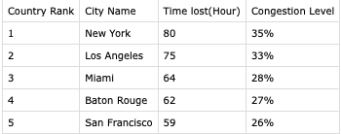
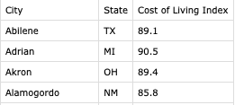
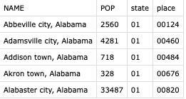
Data Source:
Traffic Condition in US cities:
https://www.tomtom.com/en_gb/traffic-index/united-states-of-america-country-traffic/
Includes city names, time lost per year, and congestion level.
Approach: scraping using requests.get(), BeautifulSoup.
Cost of Living Index in US cities
https://advisorsmith.com/data/coli/
Includes city names, the state of the city, cost of living index.
Approach: direct download using requests.get() and .decode
Population in US cities
https://api.census.gov/data/2019/pep/population?get=NAME,POP&for=place:*&in=state:*
Includes city names and state names, population number, state code, place code.
Approach: api request using urllib.request and Json.loads()

Slide 4

Obtaining and Saving Raw Data
The raw data obtained will be organized by columns and saved locally in .csv format using csv module.
Due to the size of the content, there are three terminal commands for getting data in different formats for api and scraped datasets.
Default mode: python3 [script name]
Scrape mode: python3 [script name] –scrape
Static mode: python3 [script name] --static [save path]
Example:
Notes:
In this mode, the dataset designated for downloading will be saved, and the first 5 entries in the file will be printed in the terminal.
In this mode, small samples (first 5 entries) representing all the three datasets are generated and printed.
In this mode, the full dataset will be downloaded just like the default mode, but nothing will be printed on terminal. Also, the file will be saved in the path designated in the command instead of in the same path as the script. Note: don't include the name of the file in the command, as its already been taken care of in the code.

Slide 5
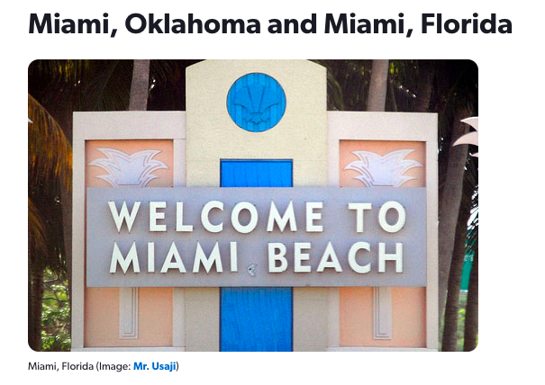
Combining Datasets into One file
Script: dataset_join.py
Reference column: city name
Procedure:
For population dataset, remove additional words like ‘city’ and ‘village’, split the city and state column into separate sets
For cost of living and scraped datasets, the city name columns can be used directly.
Match the city names in three datasets with their records and combine into one dataset.
Challenge: cities sometimes have same names.
Solution: verify the state name of the city from population and cost of living datasets.
Figure 4. William, M. (2014)
Notes:
there are some different cities in US with the same names exist in the population dataset. In order to avoid confusion, the state name from population dataset and cost of living dataset will be compared and verified when the city name matches, in order to make sure the data of the right city is taken.

Slide 6
Data Analysis
Haven’t begun!
Plan:
Use the data obtained to calculate the correlation between the traffic condition, population and cost of living in a list of US cities in order to show the potential relationship between them.
Library: numpy, matplotlib
Traffic vs population, cost of living vs population, and traffic vs cost of living.
Also, try to generalize a formula from the available data using Linear Regression approach or Monte Carlo approach (if the data trend is non-linear enough).
Anticipation of result:
All positive correlation!
Based on personal experience and common sense, but still need to be verified by data analysis.

Slide 7
Flow Chart and … Question?

Slide 8
Citation
Grad, S. (2019, November 27). How 405 Freeway gridlock became the iconic image of an L.A. Thanksgiving—Los Angeles Times. Los Angeles Times. https://www.latimes.com/california/story/2019-11-27/how-405-freeway-gridlock-became-the-iconic-image-of-l-a-thanksgiving
Christy, P. (2021, September 30). Mid-Ohio Valley Cost of Living – More Affordable Than You Think | Legacy Real Estate Professionals. Mid Ohio Valley Real Estate. https://midohiovalleyrealestate.com/mid-ohio-valley-cost-of-living/
Python (programming language). (2022). In Wikipedia. https://en.wikipedia.org/w/index.php?title=Python_(programming_language)&oldid=1084546066
Bresnick, J. (2016, August 25). How to Get Started with a Population Health Management Program. HealthITAnalytics. https://healthitanalytics.com/features/how-to-get-started-with-a-population-health-management-program
William, M. (2014, June 23). Seeing double: US cities so nice, they used the name twice. Cheapflights. https://www.cheapflights.com/news/seeing-double-us-cities-nice-used-name-twice

